Slide 1
Software Defined Wireless Network by Anyfi

Slide 2
Recap - SDWN and Anyfi
Remember our story last time?
Need for secure wifi network anytime, anywhere
Solution of SDWN by Anyfi
This time, we bring a prototype for demonstration

Slide 3
Agenda
Revision of SDWN and Anyfi
Anyfi use case introduction
Demonstration

Slide 4
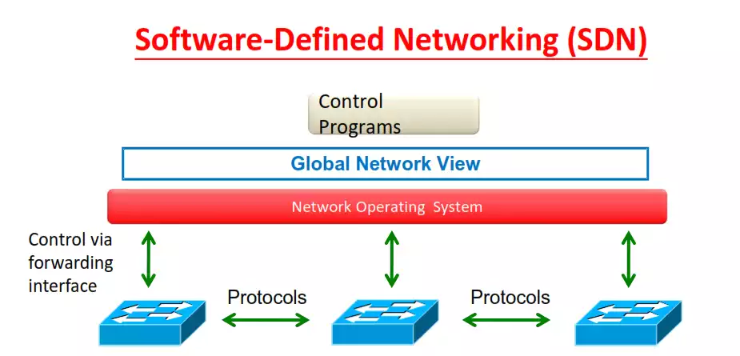
What is SDWN
Extension of SDN
Decouple Control Plane and Data Plane
Abstract underlying infrasture from wireless application

Slide 5
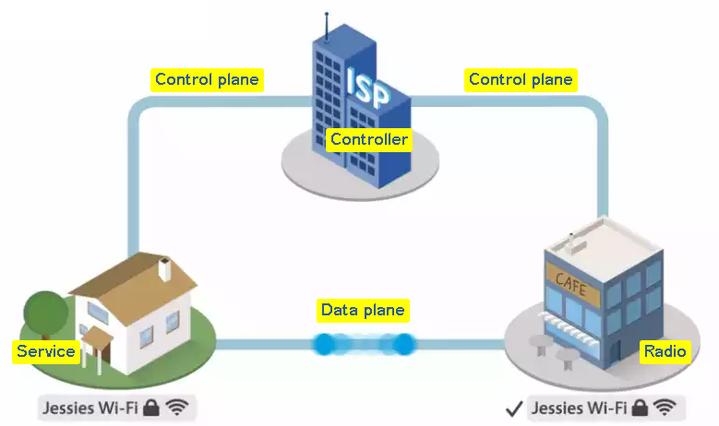
Introduction of Anyfi
SDN solution for wireless network
Separated the Radios from Service
Anyfi = Radios + Services + Controller
Notes:
AnyFi is a SDN solution for wireless network.
INNO AND DIS. IDEA. It redefined the Wifi access architecture into three components Radios, Services and controller

Slide 6
Advantages of Anyfi
Flexible
Decoupled radios and services
Centralize management
Low cost
No additional hardware, software and bandwidth required

Slide 7
Advantages of Anyfi (cont)
Secure
Strong mutual authentication
End-to-end encryption

Slide 8
What can we benefit from Anyfi in our daily life?

Slide 9
Use case
Home Wi-Fi User Experience
Access your home Wi-Fi anywhere

Slide 10
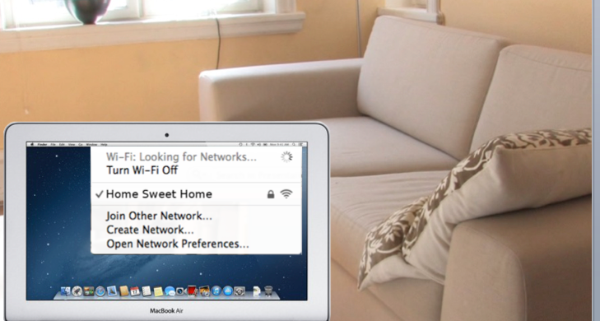

Slide 11
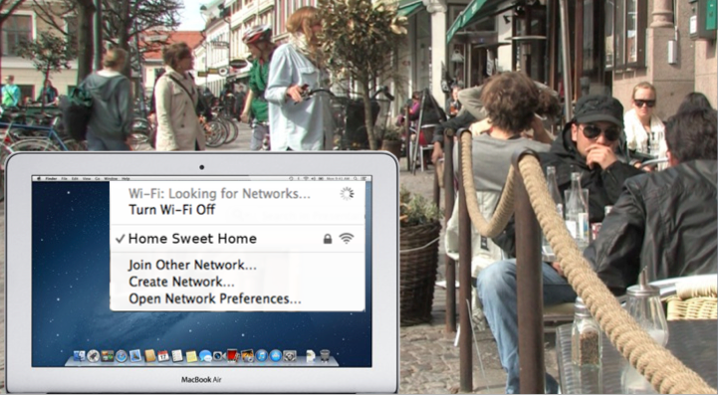

Slide 12
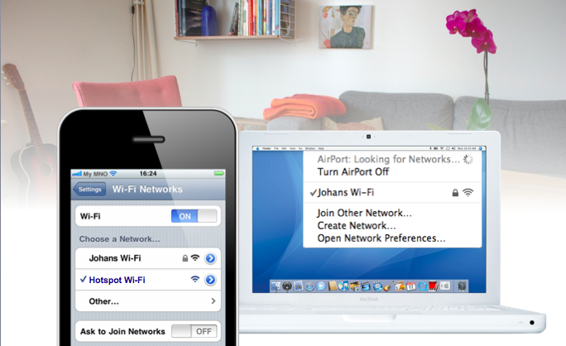
Use Case
Migrate hotspot or homespot to unified carrier Wi-Fi platform
Notes:
So let’s say I’m visiting a friend with an Anyfi.net enabled home gateway. My phone will automatically switch to Wi-Fi using my friend’s broadband connection for backhaul. Note however that my friend’s laptop will not detect this network. With Anyfi.net technology each device sees only the networks that are relevant to them.
We go to great lengths to make sure that the fixed-line broadband subscriber is not impacted by our solution in any way. Both backhaul and radio resources are carefully managed and the fixed-line subscriber’s use prioritized.

Slide 13
Demonstration
Notes:
I am going to Demonstrate a fantasy wifi access point deployment to all of you

Slide 14
Demo Resources
1 ESXi server
5 VMs
1 Firewall server
2 Wireless Mesh routers
1 Client Device
Powered by P2 Mobile Technologies Limited
Notes:
In this demo, I want to show you example of a wireless infrastructure deployment. We combine virtualization and also Software define network technology. We can finish a deployment in a very flexible and fast manner./
Even more, by using the wireless mesh technology as the internet gateway, we don’t need a single wire inside.
EsXI server is a hypervisor and it contains 5 virtual machines which are the infrastructure of this SWDN core. Suitable for fast deployment and testing.
Firewall server will bring the whole system to the Internet.
2 Wireless mesh router connected in mesh manner
one Client device

Slide 15
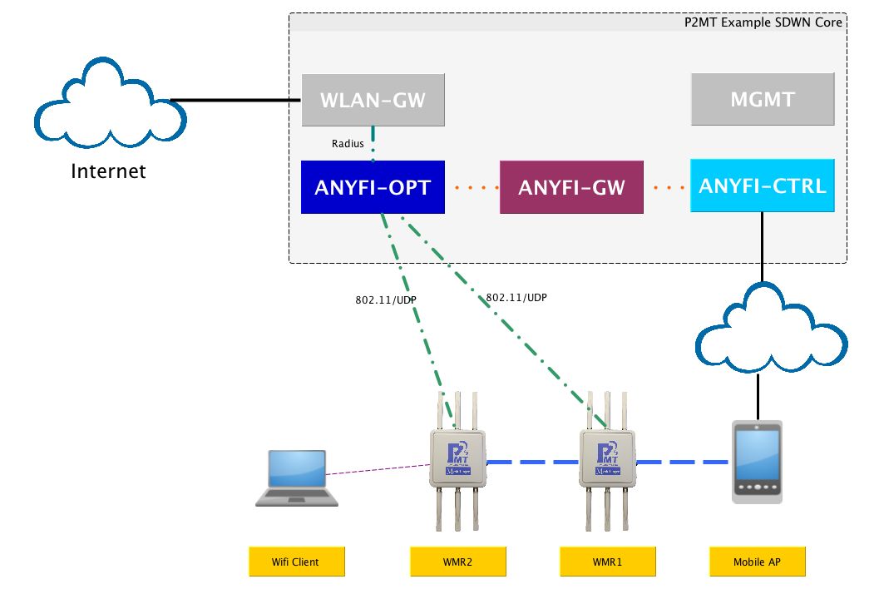
SDWN Demo Setup
Ethernet connect
Wi-Fi over IP tunnel
Anyfi control protocol
Wireless Mesh Backbone
Wi-Fi access
Notes:
mobile ap as internet gateway
mesh router form backbone and provide access to user
3 anyfi compoents are interconnected with each other to provide the SWDN service
Control plane
first control plane is formed,. mesh router connect to ANYFI-CTRL
after the Communication of the hardware resources between Routers and controller
ANYFI-GW will generate the configuration for all the wifi routers to provide anyfi service.
Data plane
ANYFI-OPT will apply policy for the data traffic and schedule the traffic to the WLAN GW for wireless service
such AAA
form tunnel to the WLAN GW

Slide 16
SDWN Demo Setup
How to setup Anyfi network
Install server packages
Compile firmware on the embedded devices
Config all the SWDN servers
How to setup Wireless Mesh Network
Back-N technology powered by P2MT

Slide 17
How’s SDWN demo works?
How does Anyfi SDN works?
Internet traffic flow
Notes:
Here is our wireless mesh router which is sponsored by P2Mobile. There two mesh router will interconnected and can access to the internet via the mobile AP.
The anyfi SDWN solution can finish all the configuration by just few click, later i will show you how easy can the deployment done.
All the wireless service configuration is done the Anyfi-gw, all the configuration will be automatically push to the mesh router after the registration.
You may want to know how can be the registration done. It is very easy, you can just input the anyfi-ctrl ip and select the interface for the anyfi service and that it.
After that all the mesh router radio interfaces will just responsible for the wireless frame distribution because all the 802.11 frame is managed by the wlan-gw.
After the wifi scanned the ssid, the wlan-gw will respond for wifi probe respond and handle all the wifi authentication.
Let me show you how the mesh work first.
WMR1 and WMR2 will connected with the radio0 and WMR1 radio1 will connected with the mobileAP.
The traceroute will show you how does WMR2 can access to p2mt.com
We will select the reminding interface for the anyfi services.
And we can input the any-fi ctrl ip here
We can see the connection here.
vyatta@anyfi-ctrl:
show anyfi controller radios
Can we can config the wireless service in the anyfi-gw

Slide 18
Achievement in the Demo
Control plane demonstration
User account management
Wireless provisioning
Data plane demonstration
Internet accessibility
Roaming
Management plane
Command Line Interface
Webpage
Notes:
Control plane demonstration
ssh admin@p2mt.com -p20000
ssh anyfi-ctrl
User account management
show service radius user
edit service radius user local peap-mschapv2 "iems5717"
set password iems5717
delete service radius user local peap-mschapv2 iems5717
Wireless provisioning
ssh anyfi-gw
edit service anyfi gateway "iems5717"
set controller 192.168.1.12
set ssid "IEMS 5717 Demo Wifi Access"
set bridge br0
set wpa2
set authentication psk passphrase iems5717test
delete service anyfi gateway iems5717
ssh anyfi-ctrl
show anyfi controller services
Data plane demonstration
Internet accessibility
roaming
Management plane
ssh anyfi-gw
Command Line Interface
ssh anyfi-gw
show anyfi gateway iems5717 clients
Webpage

Slide 19
Thanks!
ANY QUESTIONS?

